Slide 1
Instrument Detector
OrchestrAIte

Slide 2
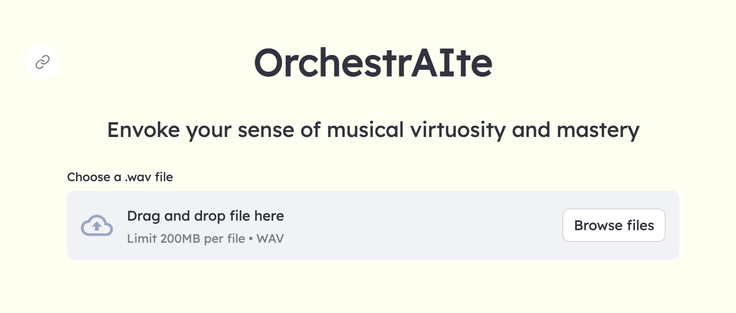


Slide 3
How a computer understands music?
🎵 → 👂 → 🎹❗️
🎵 → 💻 → 🎹❓

Slide 4
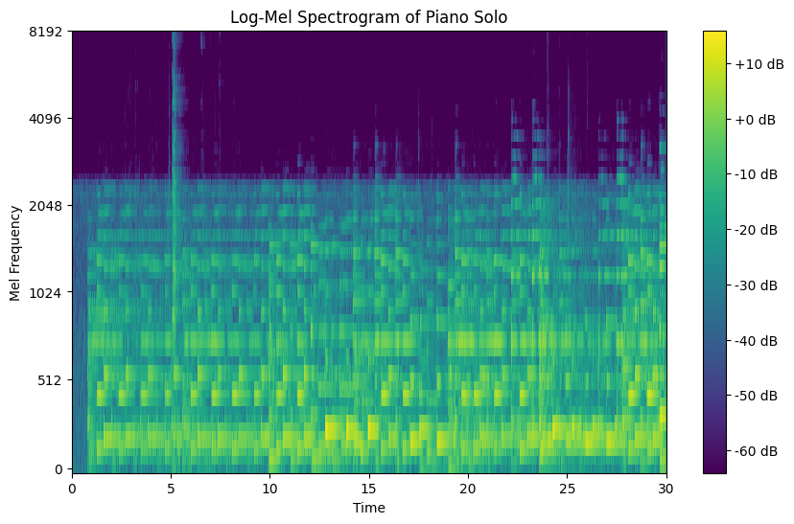

Slide 5
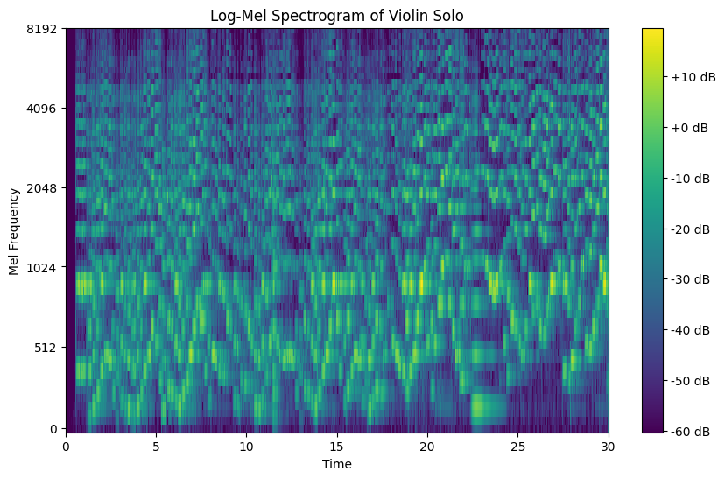

Slide 6
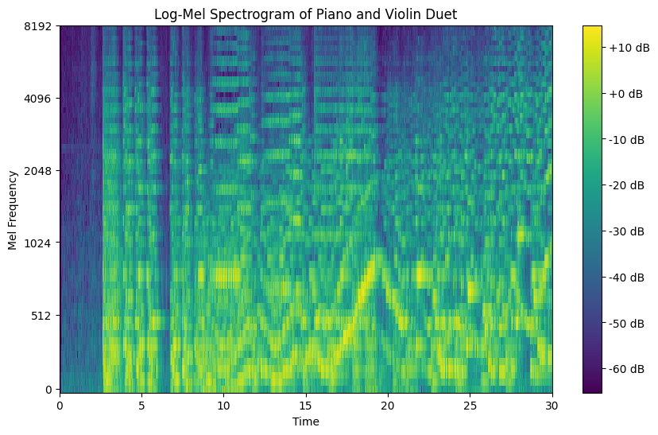

+
=
🎹
🎹 + 🎻
🎻

Slide 7
How we did it
(in just 2 weeks!)
EDA & pre-processing
Modeling
Front-end implementation
Input: log-mel specs
Output: instrument predictions
Training & Testing
Transfer learning:
VGGish
YamNet
Building custom CNN
Precision Score:
95.84% ⭐
Interface: FastAPI & Streamlit
Deployment: Docker
“MusicNet”
Data augmentation: 24,000+ audio files
Labeled data

Slide 8
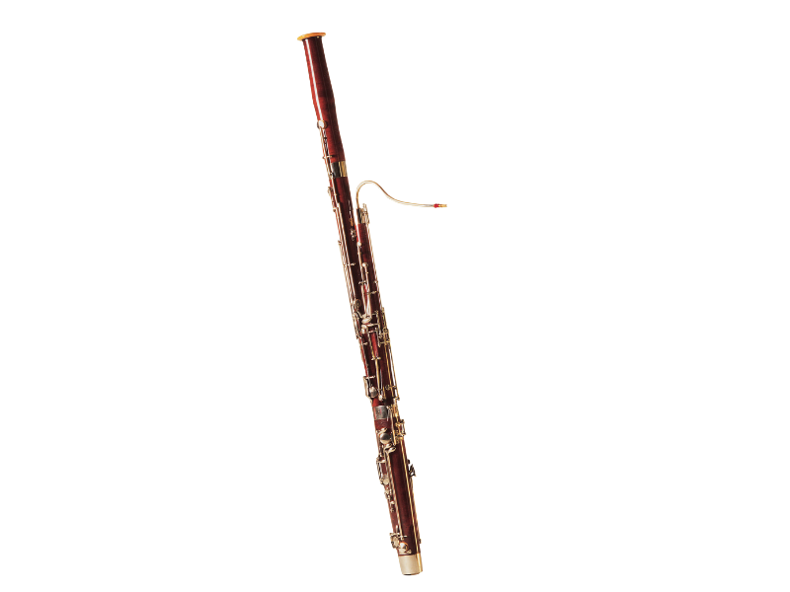
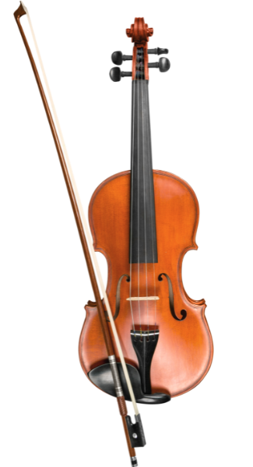
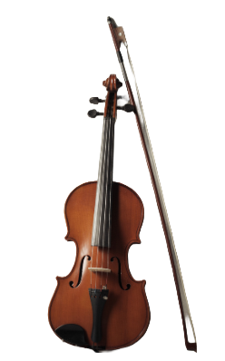
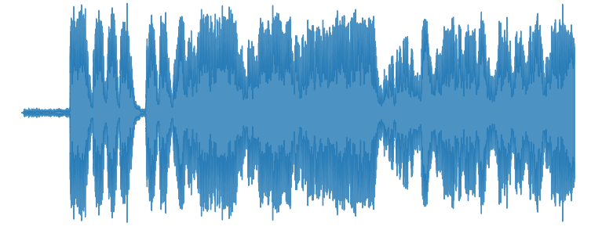
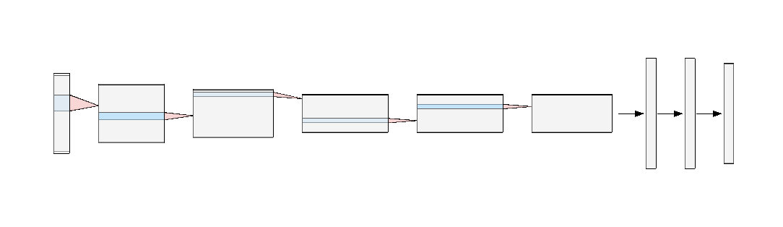
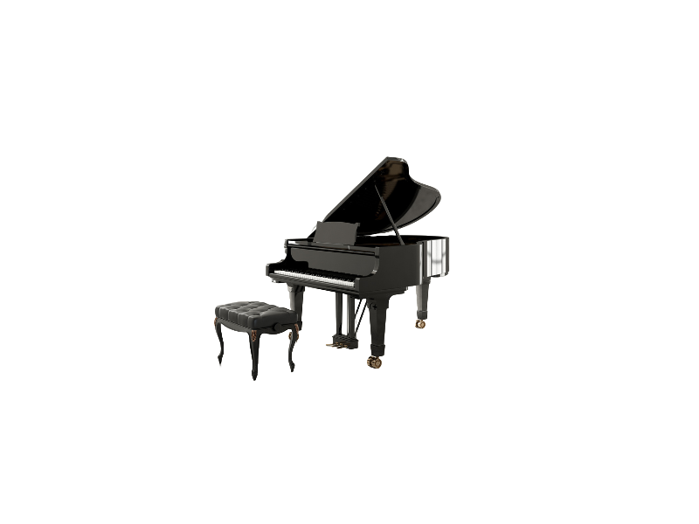
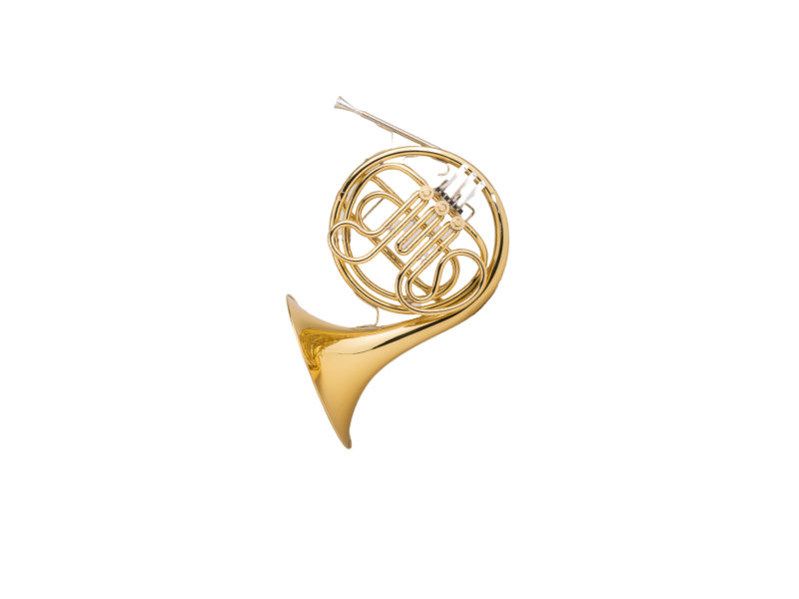
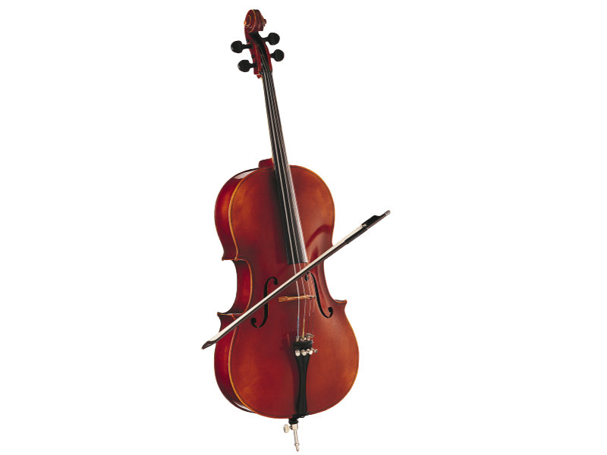
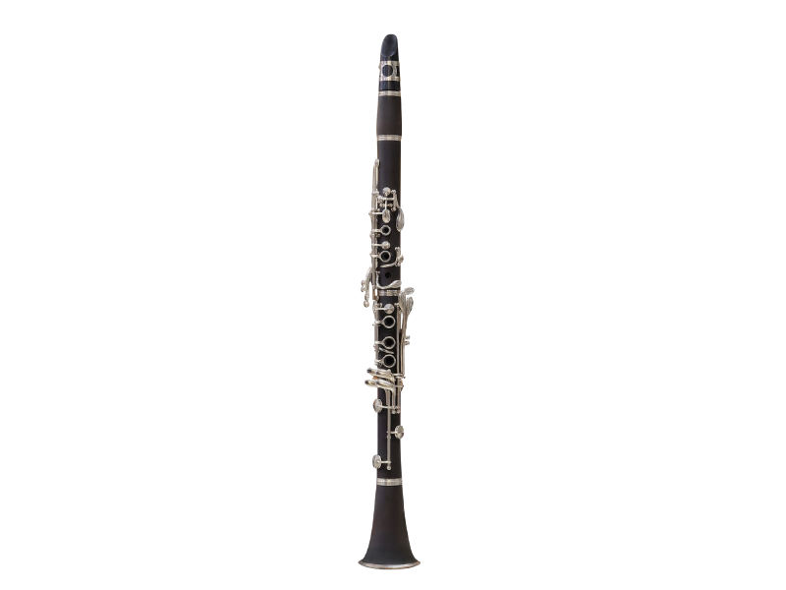
Under the Hood
🎹 + 🎻
Input
[audio file]
Processing
[Feature Extraction]
Classification [Multi-label Model CNN]

Slide 9
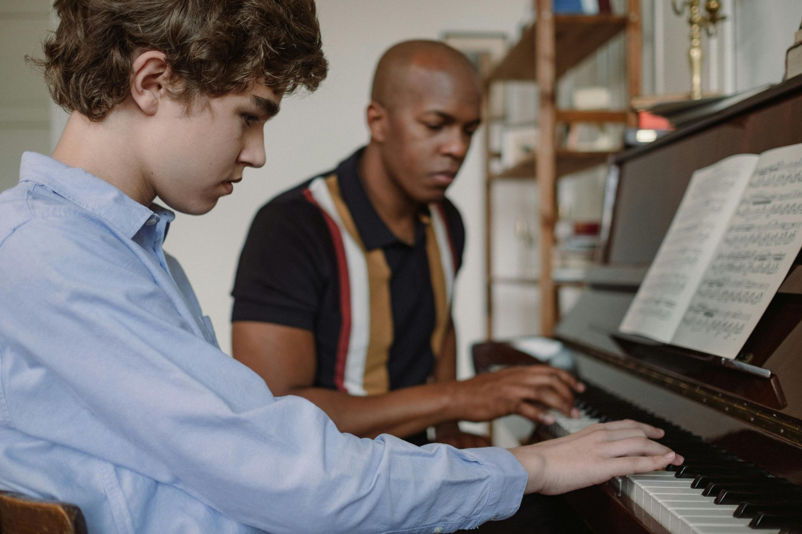
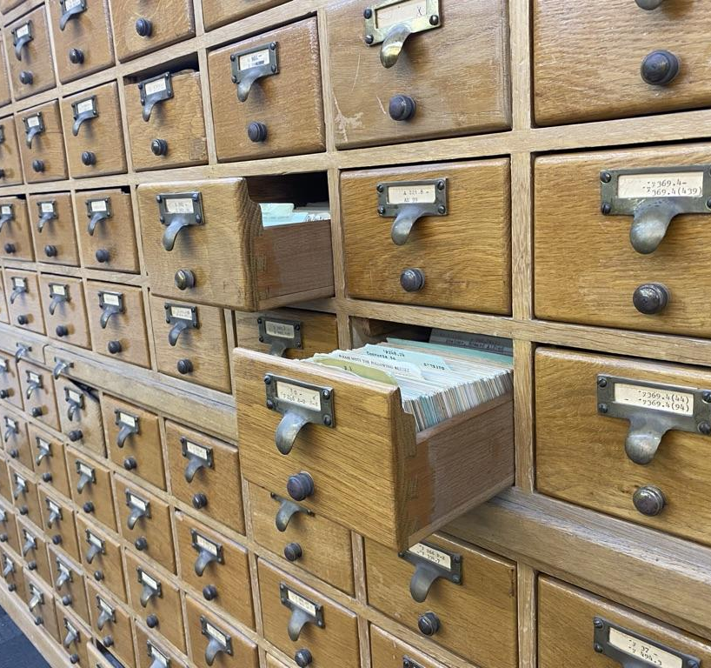
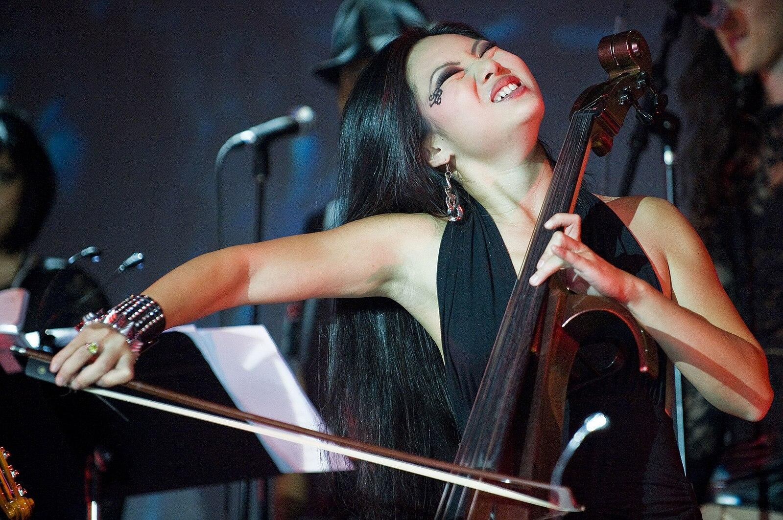
Applications
Music education
Automated cataloging
Performance analysis

Slide 10
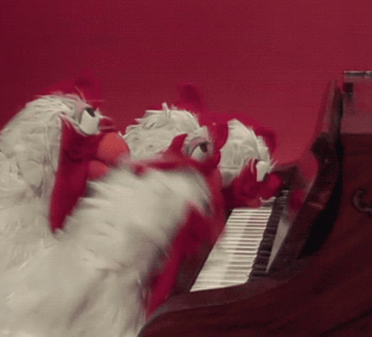
Thank you!
The team:
github.com/gusmaoandre
github.com/erricrr github.com/iamkellym
github.com/soumya-jp

